Slide 1
Lab Exercise #1

Slide 2
Data Set Description
The full data set consists of 413,770 users and 16 features. I condensed this down to 100, so it is a bit easier to manage for this assignment (will expand as I create my MLS
The data set consists of 413,770 people with data based on different factors that may contribute to depression
Link to data set source: Depression Dataset

Slide 3
Data Types
Nominal
Discrete
Name
Marital Status
Smoking Status
Employment Status
Dietary Habits
History of Mental Illness
History of Substance Abuse
Family History of Depression
Chronic Medical Conditions
Number of Children
Ordinal
Education Level
Physical Activity Level
Alcohol Consumption
Sleep Patterns
Continuous
Age
Income

Slide 4
The Problem
The purpose of this analysis is to determine large contributing factors and predictors of a depression diagnosis

Slide 5
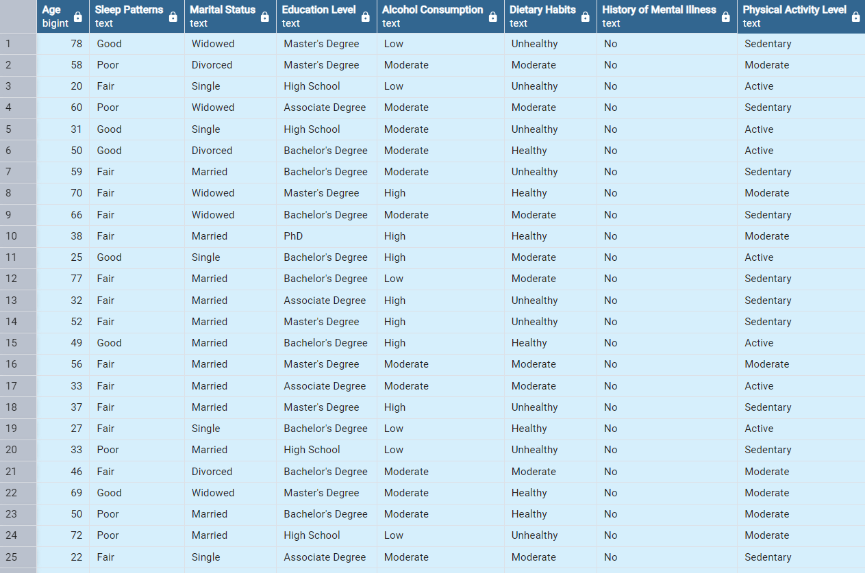
Further description & Table
Metrics and Data Table using pgAdmin:
Notes:
No Mental Health History

Slide 6
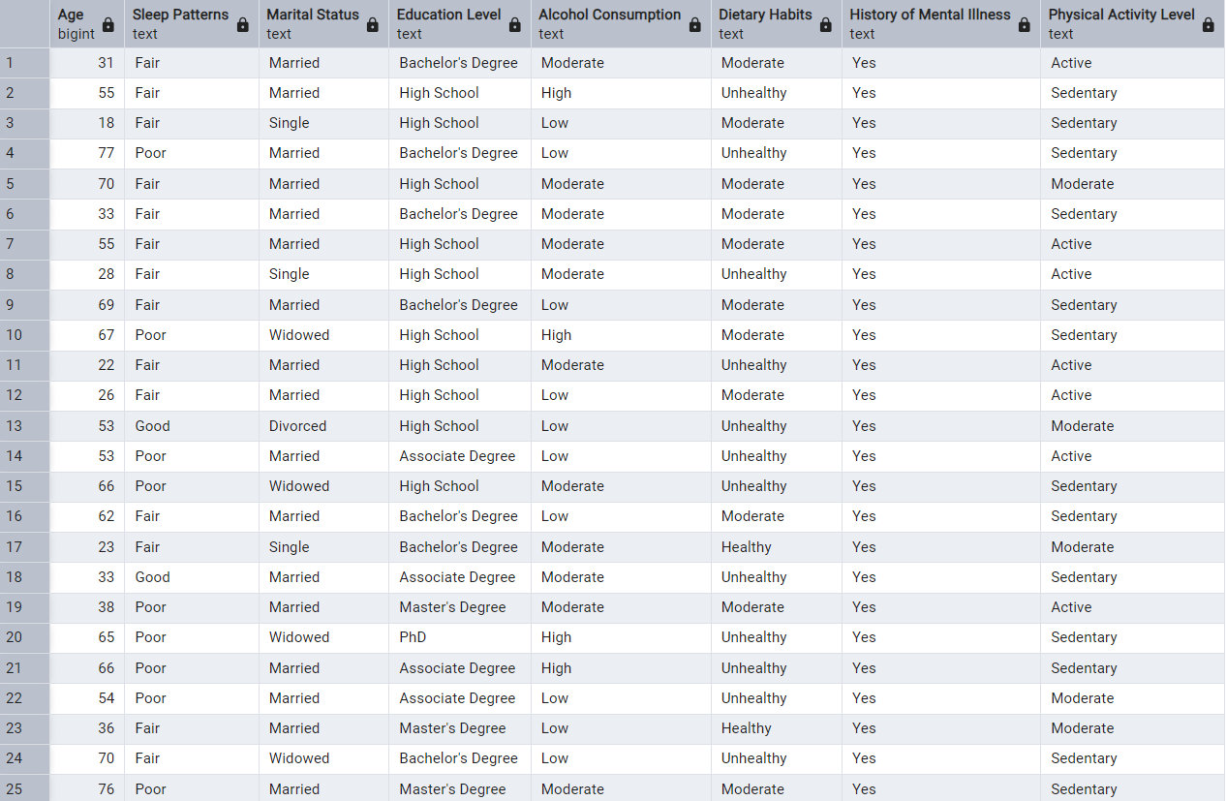
Further description & Table
Metrics and Data Table using pgAdmin:
Notes:
Yes Mental Illness History

Slide 7
Further description & Table
Metrics and Data Table using Excel:
Sleep Patterns
Count of History of Mental Illness2 | Column Labels
Row Labels | No | Yes | Grand Total | % of Mental Illness
Fair | 38 | 14 | 52 | 27%
Good | 13 | 2 | 15 | 13%
Poor | 23 | 9 | 32 | 28%
Grand Total | 74 | 25 | 99
Employment Status
Count of History of Mental Illness | Column Labels
Row Labels | No | Yes | Grand Total | % of Mental Illness
Employed | 51 | 9 | 60 | 15%
Unemployed | 23 | 16 | 39 | 41%
Grand Total | 74 | 25 | 99
Dietary Habits
Count of History of Mental Illness | Column Labels
Row Labels | No | Yes | Grand Total | % of Mental Illness
Healthy | 12 | 2 | 14 | 14%
Moderate | 27 | 11 | 38 | 29%
Unhealthy | 35 | 12 | 47 | 26%
Grand Total | 74 | 25 | 99
Notes:
These are the 3 features that directly correlate with mental illness being present. It will be imperative to conduct further research to deduce more specific inferences and conclusions.

Slide 8
Further description & Table
Metrics and Data Table using pgAdmin & Excel:
Sleep pattern, alcohol consumption, exercise, Dietary Habits, education level, and pre-existing medical conditions are all important contributing factors that can lead to depression
My goal with my machine learning model is to determine the features that contribute most to depression disorder
Considering all features provided in the data set, Sleep Pattern, Employment Status and Dietary Habits seem to be large contributors to a depression diagnosis

Slide 9
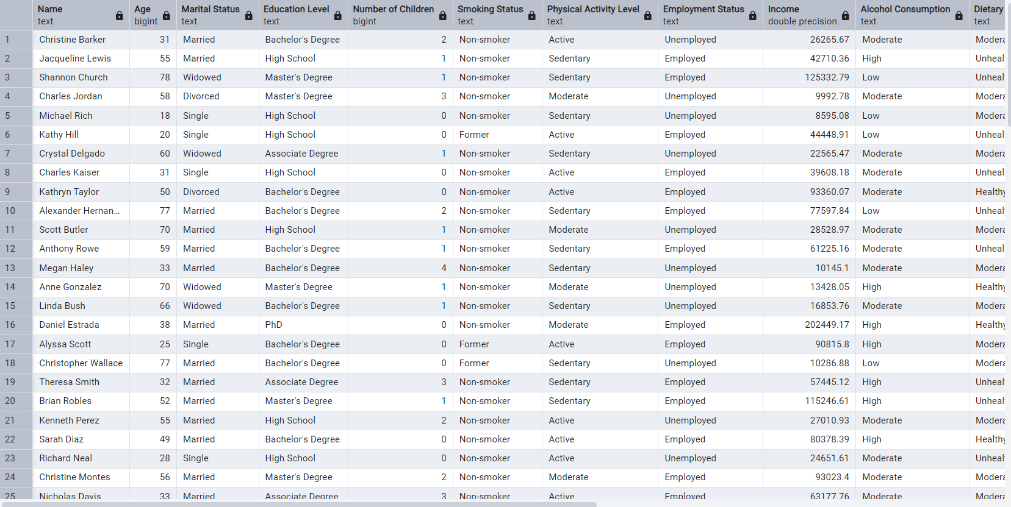
pgAdmin Raw Data

Slide 10
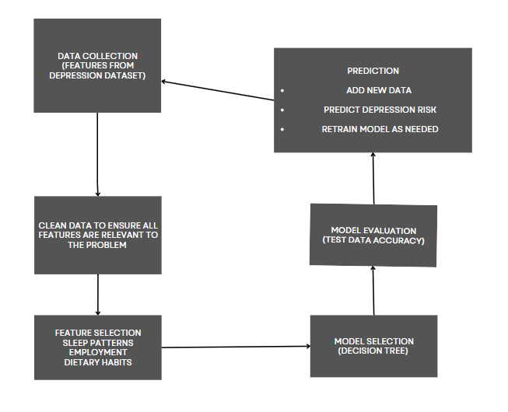
MLS Flow Chart

Slide 11
The End

